Slide 1
Automated Inventory Management System with RFID
AMARDIL SINGH DEO (TP0 )
UC3f11se
Supervised by: MR DHASON PADMAKUMAR
2nd Marker : MR ABU RUSHD

Slide 2
Problem Statement
Computerized inventory management systems are widely used to increase accuracy and reduce manpower.
Most modern systems use barcodes.
Barcodes require human operators to perform scanning.
The use of RFID can speed up the process.

Slide 3
Aim
To develop an automated inventory management system using Radio Frequency Identification technology and data analysis features to accurately keep track of inventory in a warehouse and also to provide useful data and feedback about the flow of inventory to businesses.

Slide 4
Objectives
To allow retail businesses to keep track of their inventory with greater accuracy.
To reduce the amount of manpower needed to record and update inventory information.
To allow retail staff to instantly provide up to date information about inventory to customers.
To provide staff with an easy way to place orders for new inventory with the suppliers.
To allow retail businesses to track key statistics about the flow of inventory and profits.

Slide 5
Functionalities
Administrator can create, edit or delete user accounts.
View and edit inventory information.
Place orders to suppliers.
Read inventory information from RFID scanner.
Analysis on the inventory data.
Log all changes to the database for inventory and order updates.

Slide 6
Domain Research
The importance of inventory management for businesses.
Effects of inventory accuracy on profits.
Advantages of RFID over barcodes.
RFID cost of implementation.

Slide 7
Technical Research
Programming Language: ASP.NET
Database Management System: Microsoft SQL Server 2017
IDE: Microsoft Visual Studio 2017
Libraries: Visual Studio built in libraries
Web Browser: Chrome, IE, Firefox

Slide 8
Primary Research (Observation)
Computerized point of sales systems widely used.
Some stores manually manage stock information.
Barcodes used by POS system to identify items.
POS system cannot access inventory information.
Conclusion: Retain system requirements.

Slide 9
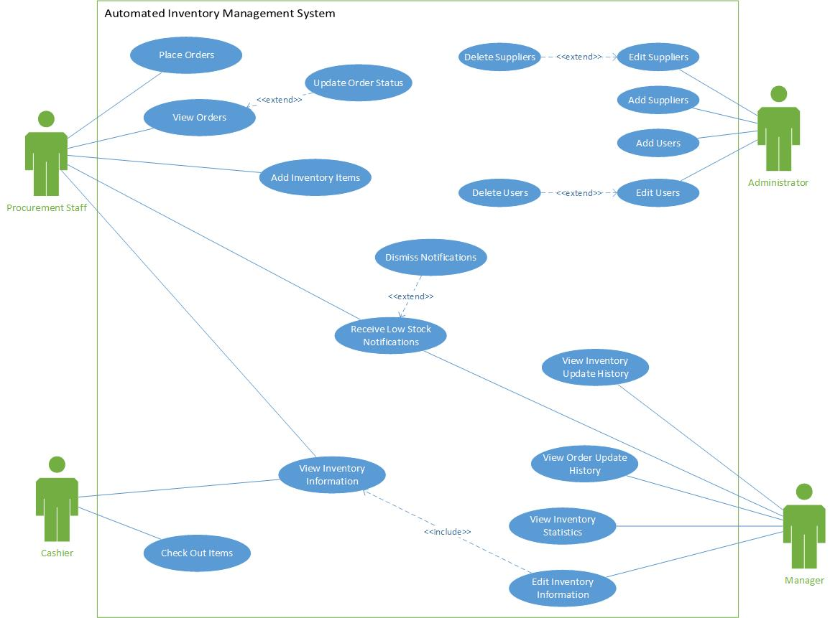
Design (Use Case)

Slide 10
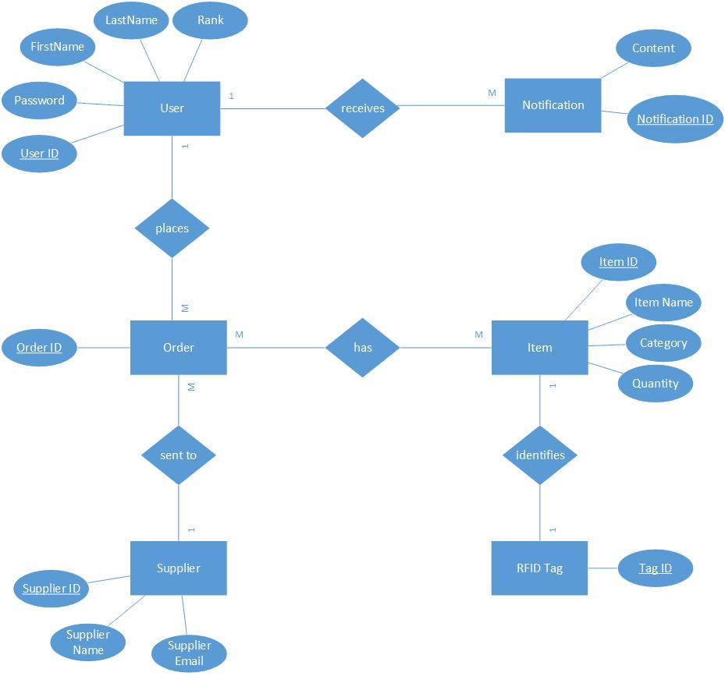
ERD

Slide 11
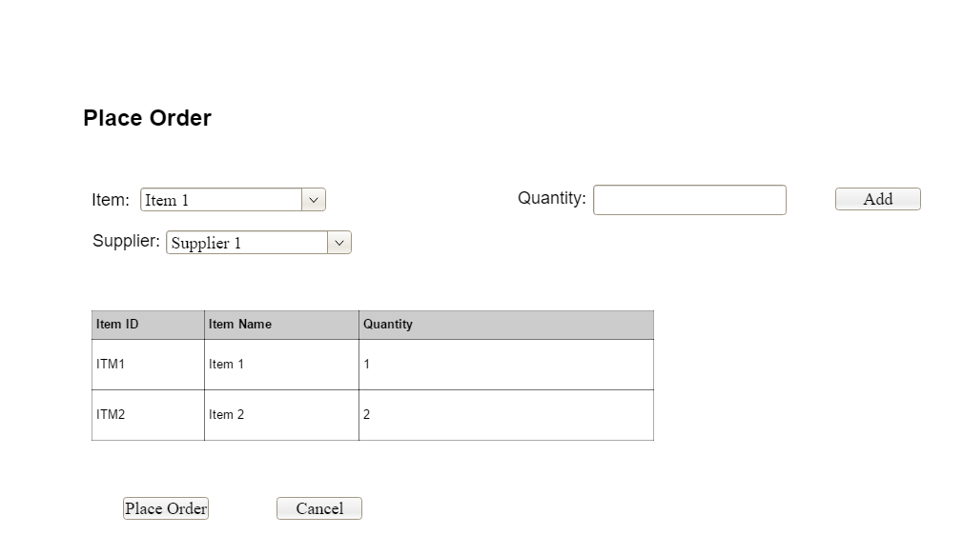
Interface design
Emphasis on user friendly design.
Target users won’t all be experts.
System must be easy to use.

Slide 12
Implementation
Integration of RFID scanner with system.
Sending e-mail orders to suppliers.
Creating dynamic tables on web pages.
Implementing Forms authentication.

Slide 13
Testing
Unit testing for all pages.
UAT done for 3 users
UAT feedback mostly cosmetic.
Increase size of text boxes or text, add new buttons, etc.
Improve search function.
Data validation, eg. Text in a Quantity box.

Slide 14
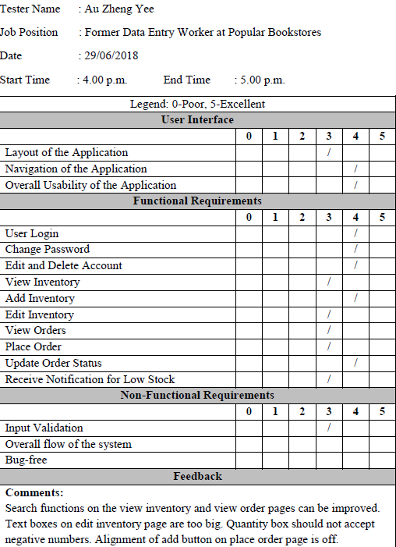
UAT Results (1)

Slide 15
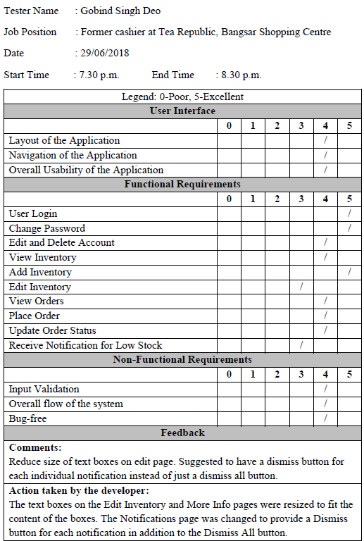
UAT Results (2)

Slide 16
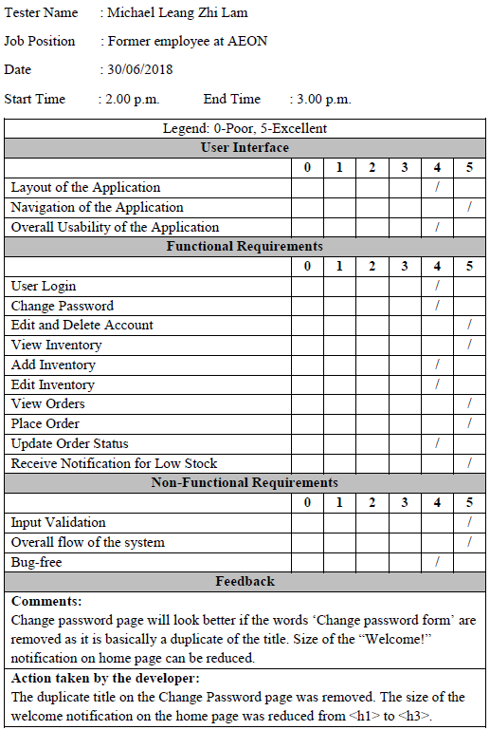
UAT Results (3)

Slide 17
Problems and Limitations
No restriction on number of login attempts.
User can log in from multiple devices.
RFID reader doesn’t have an API.

Slide 18

Future Enhancement and Planning
Advanced data analytics.
Use Secure HTTP (HTTPS) to improve security.
Full optimization for mobile devices.
Graphs and other visual data.

Slide 19
Conclusion
Learned a lot about ASP.NET and C#.
Refreshed SQL knowledge.
Learned a lot about RFID.
Challenges: choosing programming language.
Challenges: gathering data for primary research.

Slide 20
Q & A

